Slide 1
Student Activities Fund Office
(SAFO)

Slide 2
Discussion Outline
Purpose: To provide Treasurers with a better understanding of what the Student Activities Fund Office (SAFO) does for its clients, illustrate proper interaction with the Office, teach skills necessary to maximize the organization’s benefit, and set expectations for organization Treasurers
Importance: This discussion will give Treasurers the chance to learn what’s necessary to effectively perform their roles within your organizations
Preview: How to conduct business with SAFO and avoid unwanted penalties, review services offered, common forms, and monthly fees

Slide 3
Services offered by SAFO
Deposit Funds
Check Writer
Intra Office Transfers
Financial Information Requests
PayPal Accounts
Harris Teeter Card
Cash Box Rental
Direct Deposit
Wire Transfers
Online information about SAFO services as well as downloadable/ fillable forms can be found at carolinaunion.unc.edu/safo

Slide 4
Opening a SAFO Account
Obtain University Registration through the Office of Student Organizations (studentlife.unc.edu) & complete the “Request to Open a SAFO Account” application
All Treasurers must review the online training presentation & pass a SAFO test. Training presentation and link to test is available at carolinaunion.unc.edu/safo
Complete the “Request to Open a SAFO Account” application. Submission of application by Organizational officer in person and must present a Valid OneCard or Picture ID
Treasurer/President will receive
  Email notification of approval/denial
  Email notification with account number if approved

Slide 5
Maintaining a SAFO Account
All Student Organizations must register annually through Student Life & Leadership’s Office of Student Organizations (studentlife.unc.edu)
All incoming Treasurers must review the SAFO Treasurer Training presentation and successfully pass the associated test found on the Carolina Union’s student life portal page in the “Forms” section
If an Organization plans to apply for Congress Funding the incoming Treasurer is required to take the Treasurer’s Test annually
Link for Treasurer’s test can be found at carolinaunion.unc.edu/safo/resources or at http://congress.unc.edu/treasurers_test/

Slide 6
Treasurer Responsibilities
Maintaining current and accurate records of all transactions
Having the latest ledgers and spreadsheets
Ensuring the accuracy and validity of all financial paperwork relating to SAFO, including check requests and deposit slips
Communicating with both your organization and SAFO staff regarding organizational changes & filing required paperwork

Slide 7
Conducting Business with SAFO
Student Organization’s information is confidential
Only the Treasurer, President & Advisor have access to funds and information regarding account
Valid OneCard or Picture ID will be checked against the organization’s Student Life portal page
Proper support documentation is required for all check requests
Funds availability will be verified prior to any check disbursements
Payee cannot be the signer on check requests

Slide 8
Account Numbers and Fund Codes
Account numbers consist of four digits (ex. 0035, 0201, 1112)
Organizations that have been in existence for some time may have originally been issued a three digit account number and must remember to include a zero in front of their account number if needed to represent all four digits
Fund Codes are used to distinguish the funding source of monies held in a student organization account. Currently, 10 fund codes exists
    01 – General Fund 06 – Residence Halls
    02 – Carolina Union 07 – Sport Clubs
    03 – Student Legal Services 08 – Fraternities
    04 – Student Government 09 – Sororities
    05 – Activity Fee 10 – Grants & Projects

Slide 9
Deposits
  Any member can make a deposit
  Deposits must have a correct REVENUE code
  Treasurer’s responsibility to confirm accuracy of information on deposit slip and reviewing checks prior to deposit to ensure:
    Checks are signed
    Written amount must match the dollar amount
    Address of check holder
    Checks must be made payable to the organization
  Deposits credited to account within 2 business days
  Funds will be available immediately
  Transfers are not deposits

Slide 10
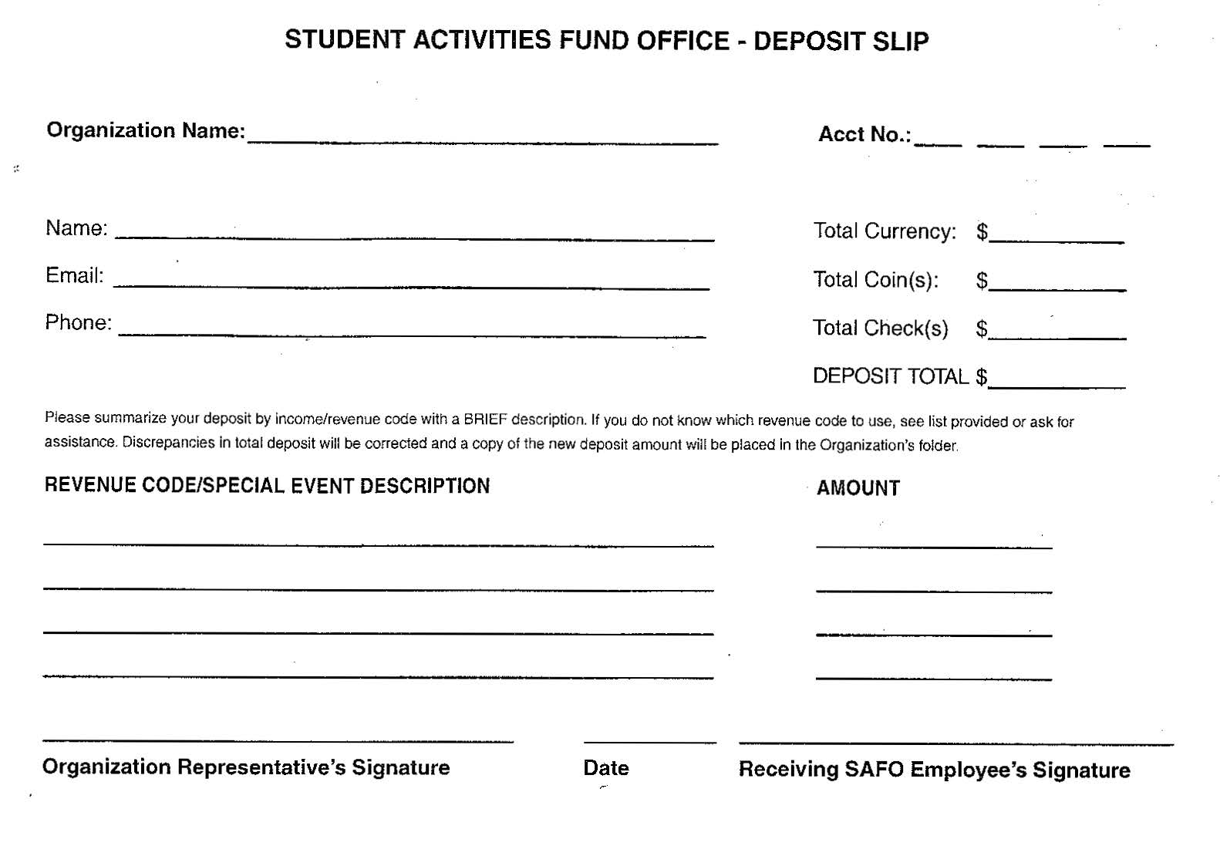
Deposit Form
REQUIRED INFO!
Revenue Code & Detailed Description is required

Slide 11
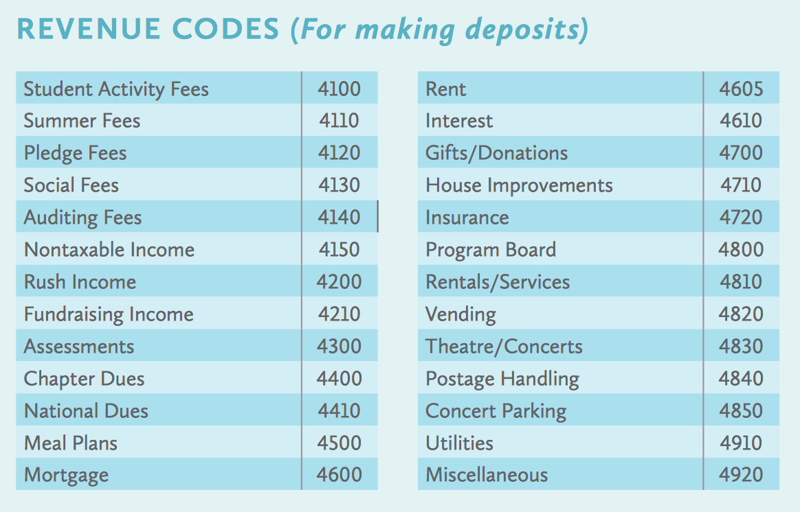
SAFO Account Revenue Codes

Slide 12
Check Process and Distribution
Weekly, check requests submitted by 4:30 p.m. on Monday will be ready after 1:00 p.m. on Wednesday of the same week when requested by the organization's Treasurer, President or Advisor (for invoices and reimbursements). Forms can be found on our website
All check requests require proper documentation to prove legitimacy of the request and must have correct EXPENSE codes
SAFO is not able to apply payment or reimbursement to the purchase of alcohol, tobacco or firearms
  In order for our office to comply with this directive, it is imperative that all receipts and invoices show itemization
Organizations can elect to have checks picked up by the Treasurer, President, Advisor or Payee. A valid OneCard or picture ID must be presented
All checks not picked up will automatically be mailed two weeks after the issue date

Slide 13
Check Request Account and Payee
A check request must contain the address of the payee and not a substitute address. All check requests issued to UNC affiliates must contain their PID number.

Slide 14
Check Request – Line Details
Line item details are reflected on an Organization’s general ledger to facilitate the tracking of expenses. This provides the opportunity to Treasurers to detail specific event expenses or reimbursements.

Slide 15
Check Requests for Student Gov. Funds

Slide 16
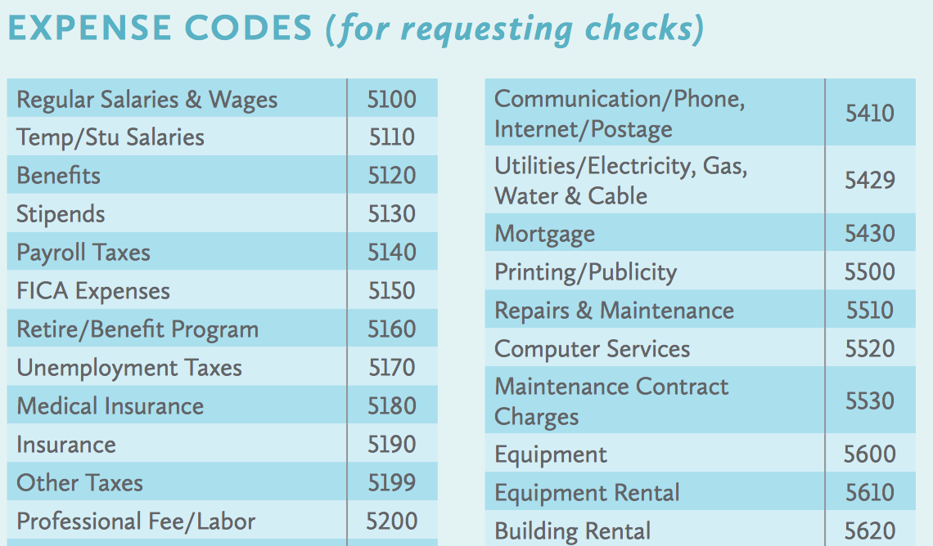
SAFO Account Expense Codes

Slide 17
Check Requests for Invoice Payment
Payable to a vendor/individual who has provided services
  Invoices should be clear in the language for services rendered (e.g. website design), have an invoice number, name & address of the vendor and the amount due
  W-9 is required for payments to vendors, contractors & payments that are considered income i.e. stipend, scholarship, honorarium, grant or donation
  NC 4% Withholding for non-resident vendors if over $1,500
Electronic submittal of Invoices to SAFO@unc.edu with appropriate documentation by authorized individual via UNC email
Incomplete submissions will not be accepted

Slide 18
Check Requests for Reimbursements
Check requests for reimbursements must be submitted in person by the Treasurer, President or Advisor. Electronic & incomplete submissions will not be accepted
The payee and submitter cannot be the same person
Check requests for reimbursements are for purchases that have already been paid for and payee is in receipt of goods purchased
Original itemized receipts must accompany a completed and signed SAFO Check Request form. The University requires that all receipts must be itemized; we cannot accept receipts that only show the amount paid

Slide 19
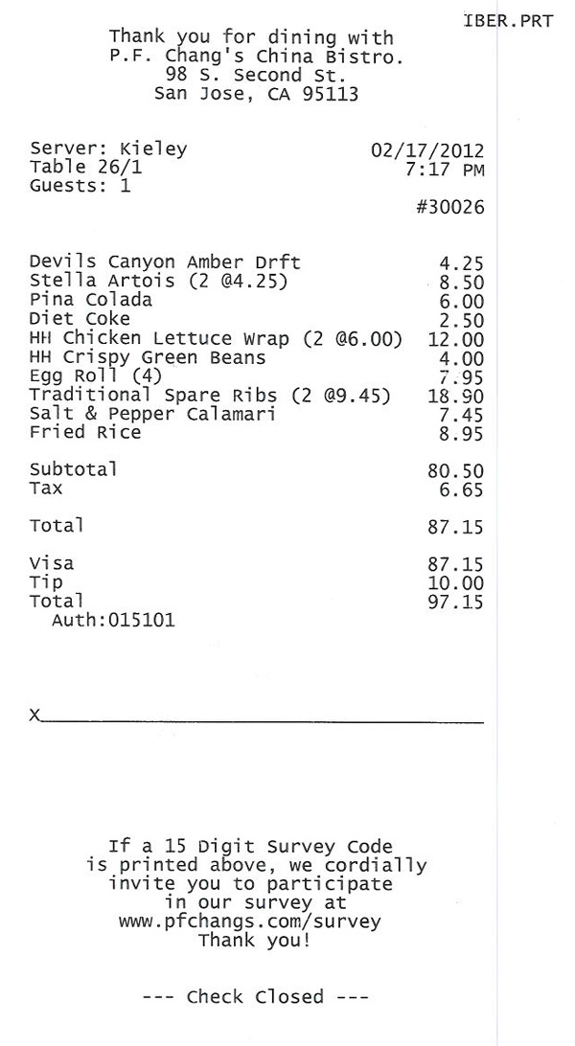
Reimbursement Receipts
ITEMIZED – REJECTED DUE TO ALCOHOL ON TAB
NOT ITEMIZED

Slide 20

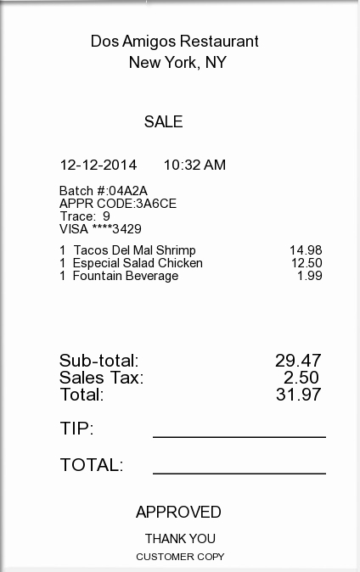
Receipt is Itemized
Shows payment

Slide 21
Voided Check/Stop Payment Request
When filling out check requests, please verify that all the information is correct to avoid unnecessary fees
There is a $30 fee for all voided/stop payment requests
Voided Check/Stop Payment requests must be signed by both the Treasurer and President of the organization

Slide 22
Stipends
Stipends are treated as income and therefore can be taxable
Stipend process
  Stipend request form
  W-9
  Examples of supporting documentation
    Award letter (for 1X stipend/grant)
    Original signed letter from department/organization’s advisor
    Legislative bill
  If applicable, a direct deposit form with a voided check
  Supporting documentation should not use the term “reimbursement” in its language

Slide 23
Harris Teeter
HT charge card available. No need to front $$
First come, first served
2 day hold limit
Counts as one transaction and posted to GL at month end
Tax exemption

Slide 24
PayPal
SAFO offers organizations the option of opening a PayPal account
Benefits
    One-time fee to set up & maintain ($30)
    Allows organizations to accept credit cards
    Monies transferred to SAFO account once a week
    No limit to activity – counts as one SAFO transaction when calculating monthly service fees

Slide 25
Financial Reports & Requests
  General Ledger Report – Weekly report that provides all the transactions that were recorded to each account in detail
  Combined Balance & Income Statement
    Balance Sheet (BS) – Provides a snapshot of financial position of Assets and Liabilities
    Income Statement (IS) – Provides a snapshot of Revenues and Expense YTD
  Financial Information Request – Submission by Treasurer, President or Advisor of the organization via their UNC email. (examples: listserv updates, transaction inquiries, copies of financial statements or reports)
  A request must be submitted to be added to the listserv to receive reports & updates.

Slide 26
Fees
SAFO’s fee structure is reviewed and set by the Student Fee Audit Committee, an independent agency of Student Government
No fee to set up/establish a SAFO account
What counts as a transaction?
  Checks, deposits, transfers
  Stop payment, PayPal (1x per month)
  Appropriations, reversions
  Correction due to errors by the client
Charged directly to an organization's account on a monthly basis, based on the actual number of transactions

Slide 27
Fee Structure
For the 2016-17 fiscal year the transaction fees are calculated on a cumulative basis:
  1-3 transactions per year = $28 annual fee
  4-10 transactions per year = $95 annual fee
  11-25 transactions per year = $145 annual fee
  26-50 transactions per year = $245 annual fee
  51-100 transactions per year = $290 annual fee
  101-250 transactions per year = $390 annual fee
  251+ transactions per year = $555 annual fee
Wire Transfer Fee $50
Stop Payment Fee $30
Setting up/Maintaining a PayPal Account $30

Slide 28
General Information
SAFO Staff:
Business & Finance Director that oversees SAFO
Account Manager
Accounts Payable Manager
Cash/Payroll Manager
Office Manager
Student Office Assistants
Office Hours: Mon – Fri 8:00 am – 5:00 pm
Closed on University Holidays
Additional closures posted regularly on website
Email: safo@unc.edu * Website: carolinaunion.unc.edu/safo * Phone: (919) 962-1159 * Fax: (919) 962-7236
Revised 1/11/2017

